Slide 1
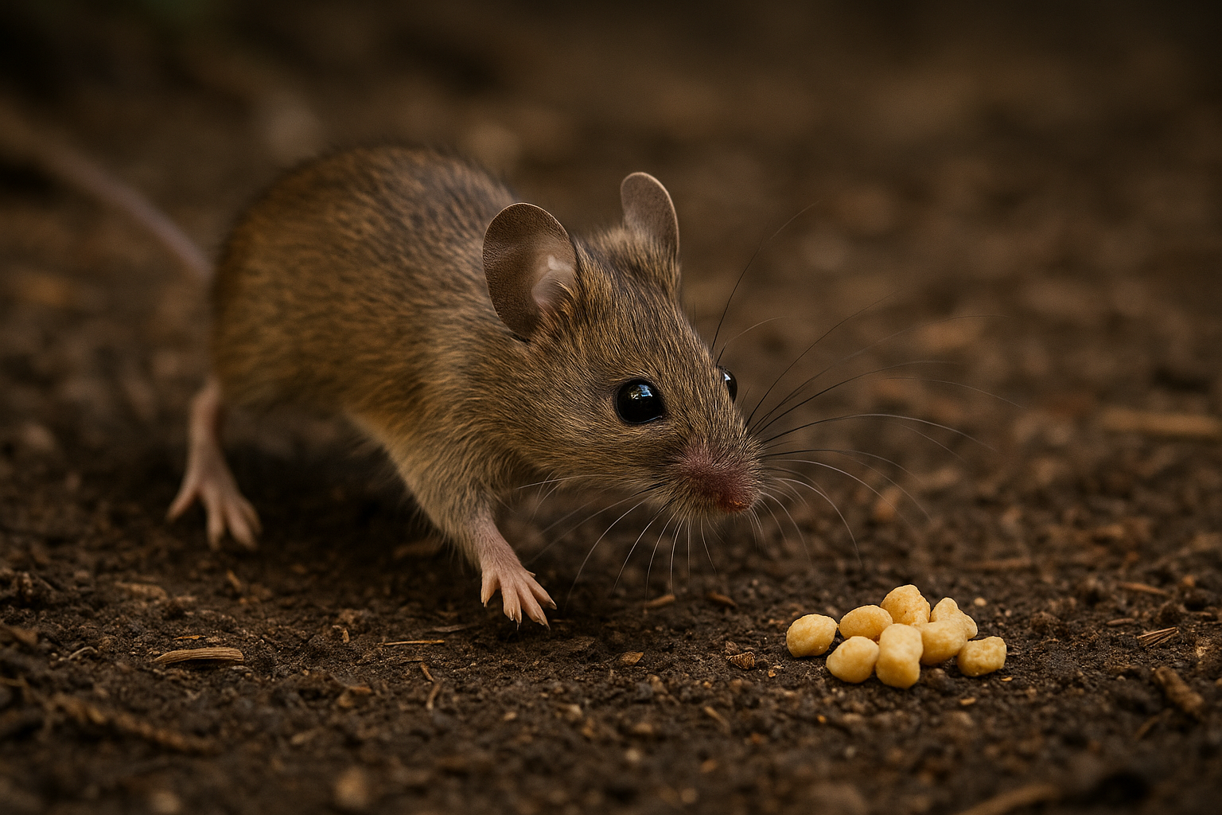
Sensory modulated interactions between olfactory bulb hippocampus and behavior
Hippocampus
Sensory regions
Motor output
+
Dynamical world

Slide 2
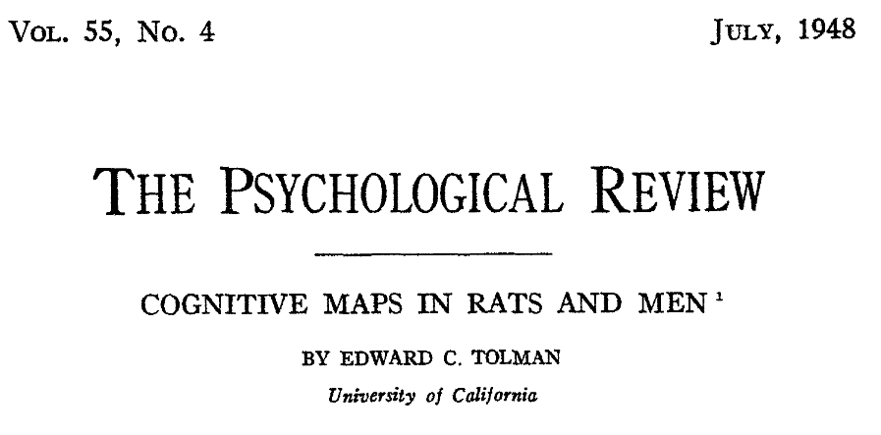
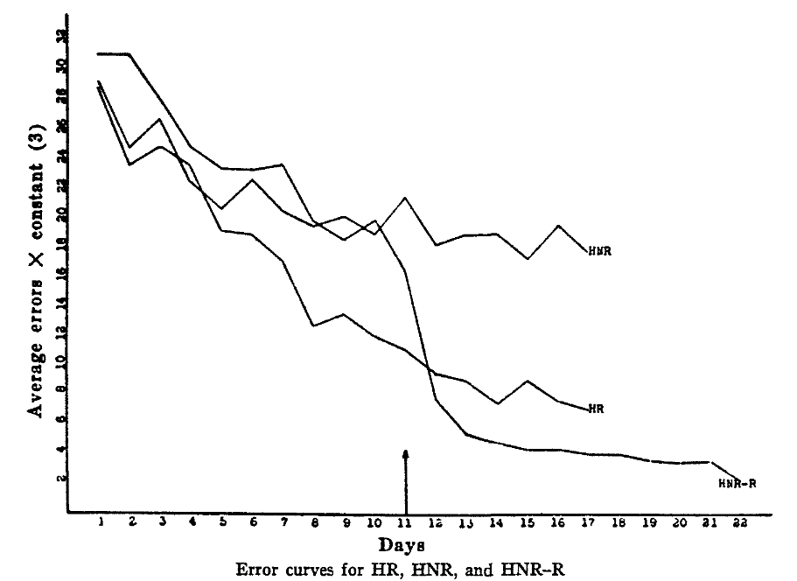
Cognitive maps & navigation
Rats form internal cognitive ‘field maps’ of environment
Latent learning
(Tolman, 1948)

Slide 3
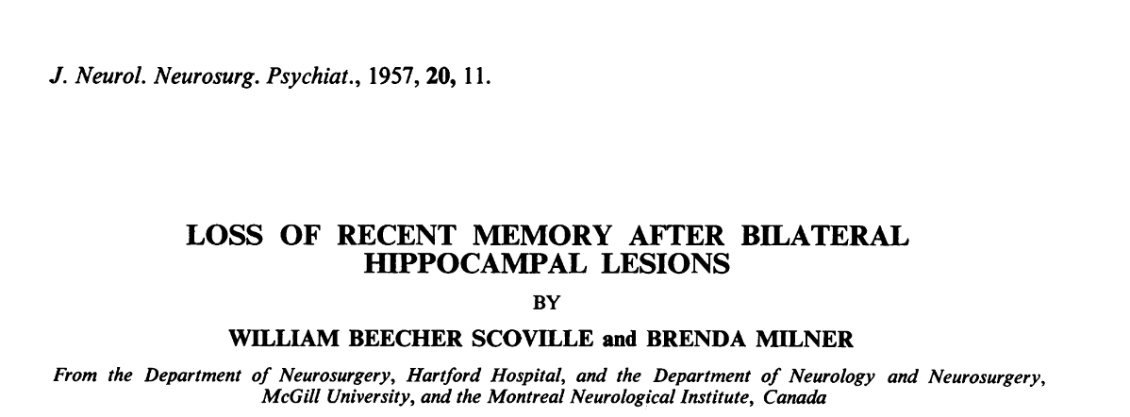
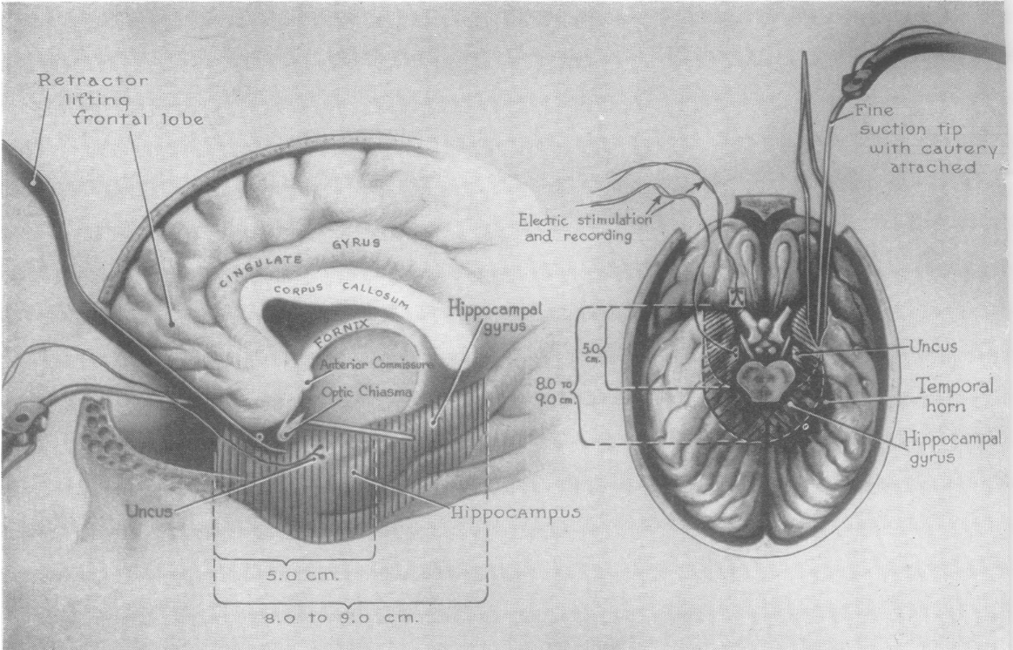
Hippocampus & cognitive maps
Hippocampus necessary for human episodic memory
(Scoville and Milner, 1957)

Slide 4
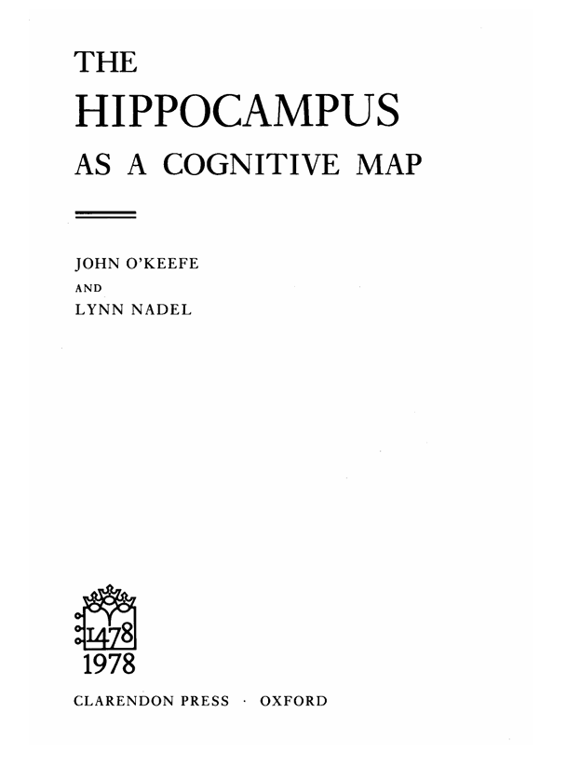
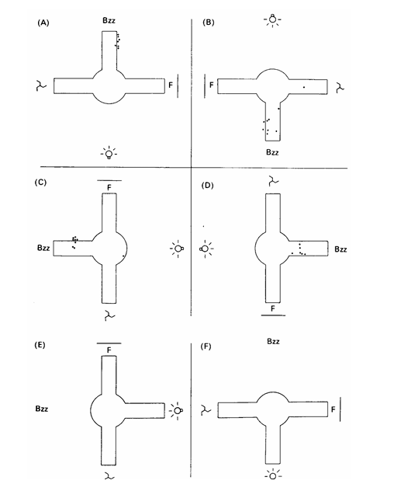
Hippocampus & cognitive maps
Hippocampus necessary for human episodic memory
Hippocampal neurons fire with selective spatial tunings
(O’Keefe & Nadel, 1978)

Slide 5
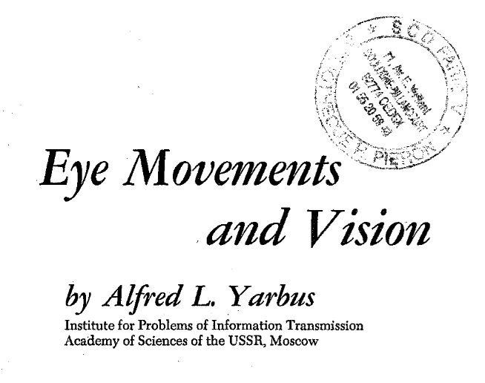
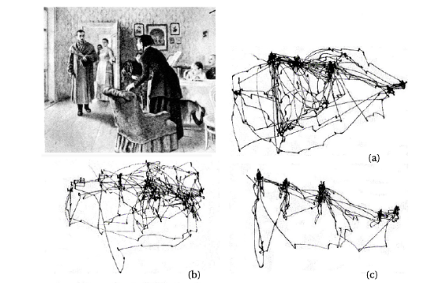
Active sampling
Being-in-the-world is an active process
(Yarbus, 1967)

Slide 6
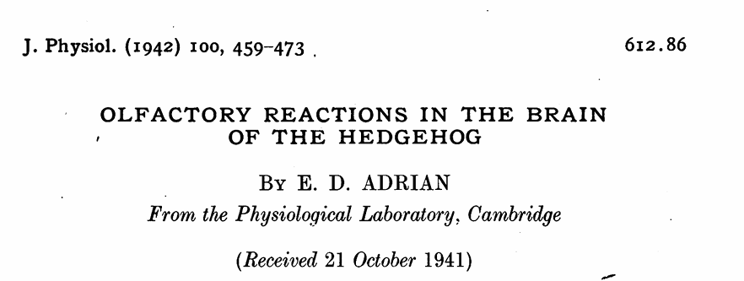
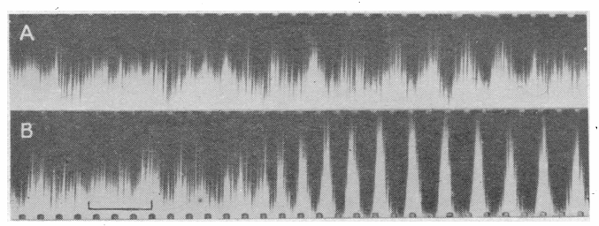
Active sampling
Being-in-the-world is an active process
Neuronal oscillations in sensory regions track sampling behavior
(Adrian, 1942)

Slide 7
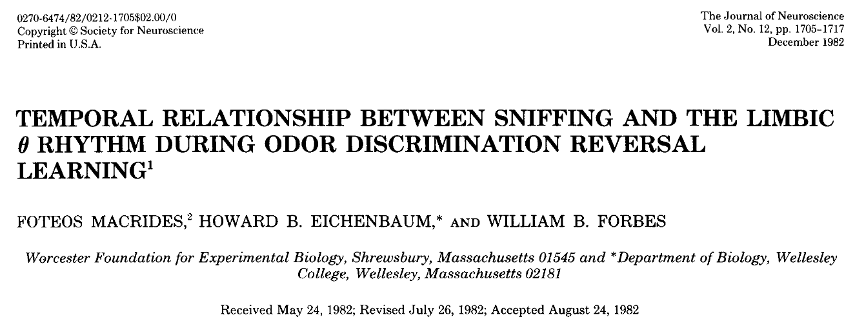
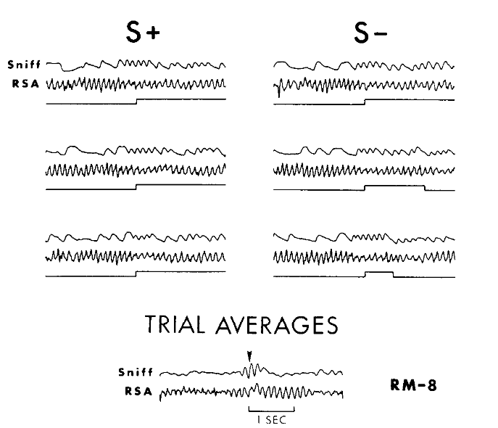
Active sampling
Being-in-the-world is an active process
Neuronal oscillations in sensory regions track sampling behavior
Hippocampal oscillations selectively coherent with sensory region and behavior
(Macrides et al., 1982)

Slide 8
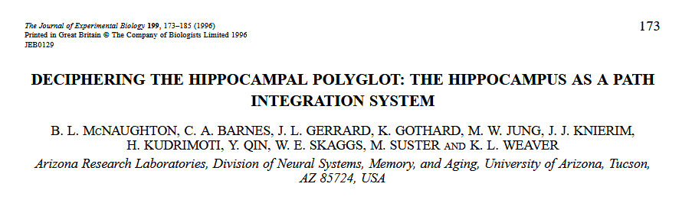
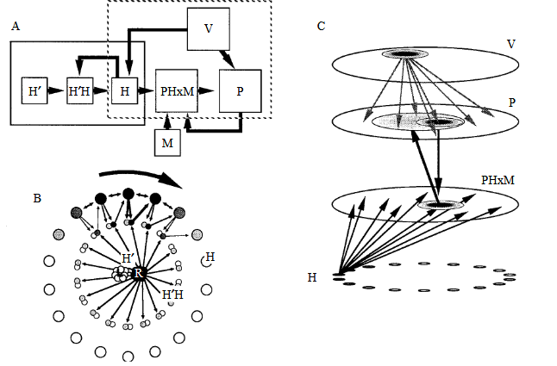
Self-organized mapping through action
Grid and place cells rely on body-derived signals
Path integration
(McNaughton et al., 1996)

Slide 9
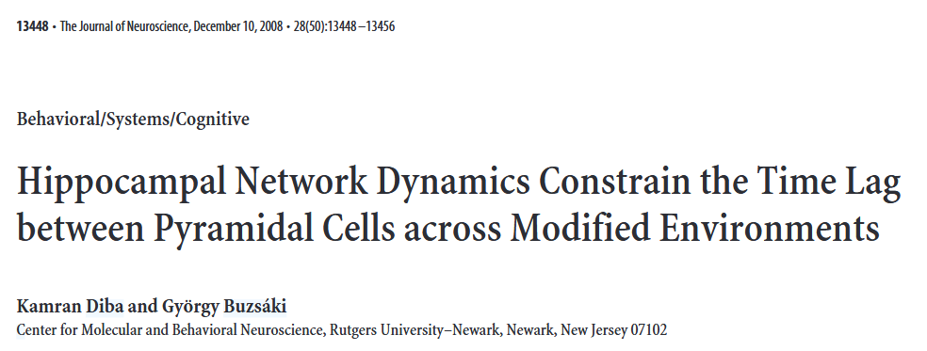
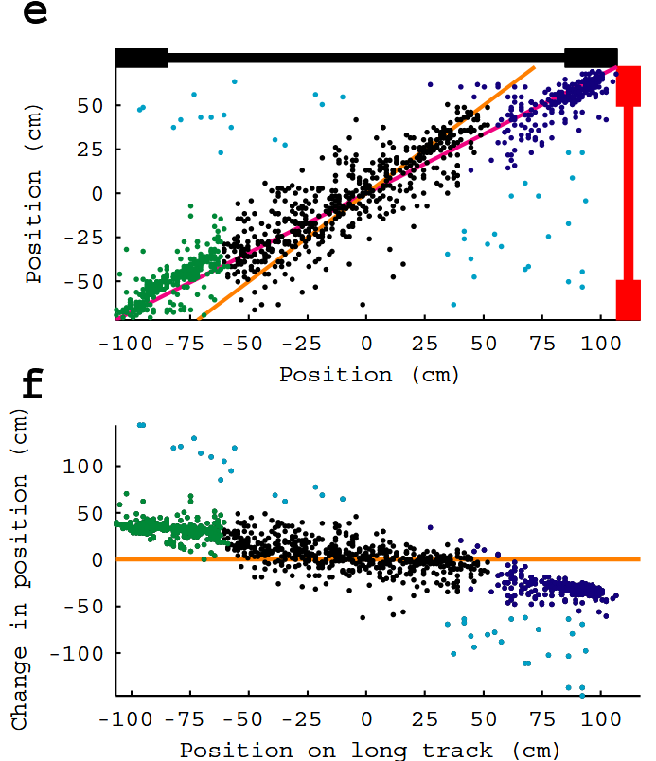
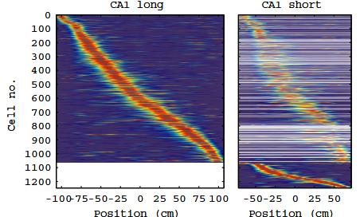
Self-organized mapping through action
Grid and place cells rely on body-derived signals
Path integration
Context dependent place cells
(Diba & Buzsáki, 2008)

Slide 10
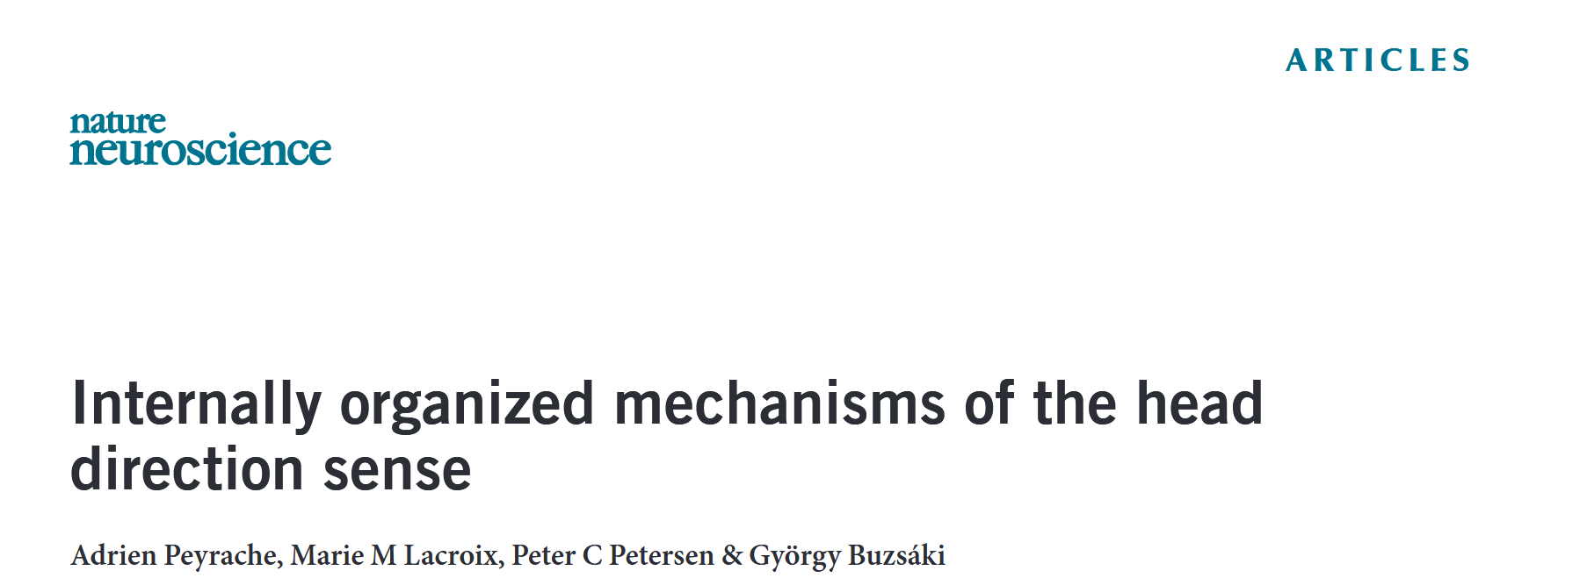
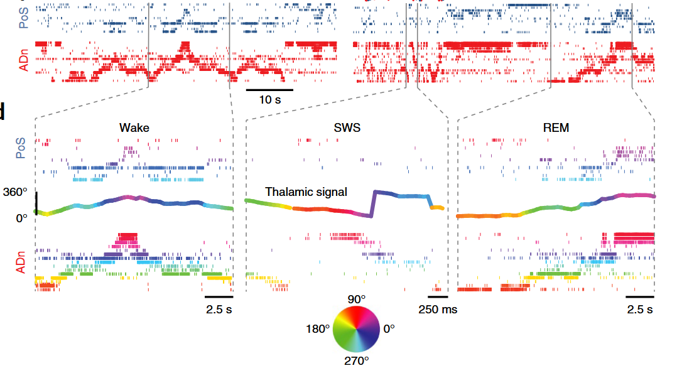
Self-organized mapping through action
Grid and place cells rely on body-derived signals
Path integration
Context dependent place cells
Single unit correlations maintained during sleep
(Peyrache et al., 2015)

Slide 11
Sensory grounding through action
Did I move or did the world change?
Sensory inputs and action signals should converge in the brain
Where?
Existing cognitive map used to compute change
Hippocampus
Sensory regions
Motor output
+
Dynamical world

Slide 12

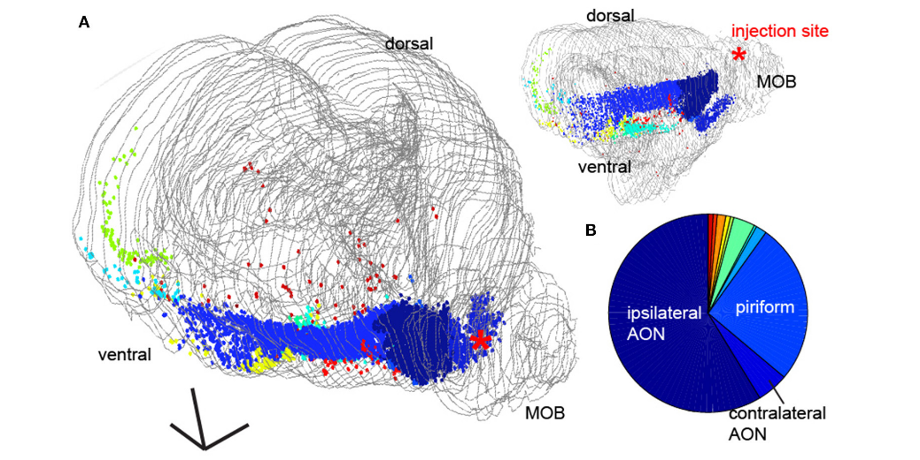
Centrifugal inputs to the olfactory bulb
Anterior olfactory nucleus
Piriform cortex
Horizontal limb of the diagonal band
Amygdala
Hippocampus
Lateral entorhinal cortex
Locus coeruleus
(Padmanabhan., 2019)

Slide 13

Sniffing and place
OB LFPs track sniffing
(Rafilson et al., 2025)

Slide 14
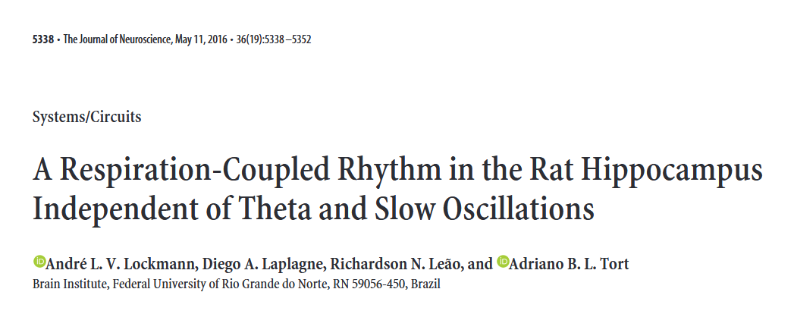
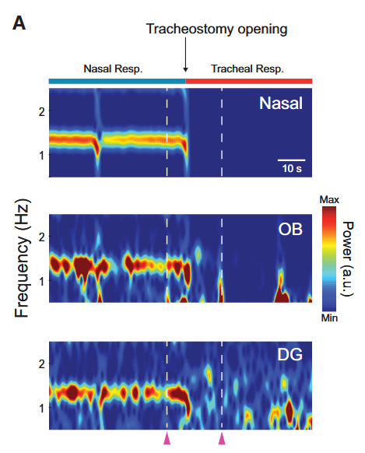
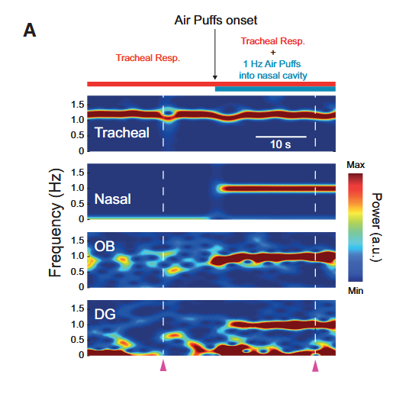
Sniffing and place
OB LFPs track sniffing
Nasal respiration is necessary and sufficient
(Lockmann et al., 2016)

Slide 15
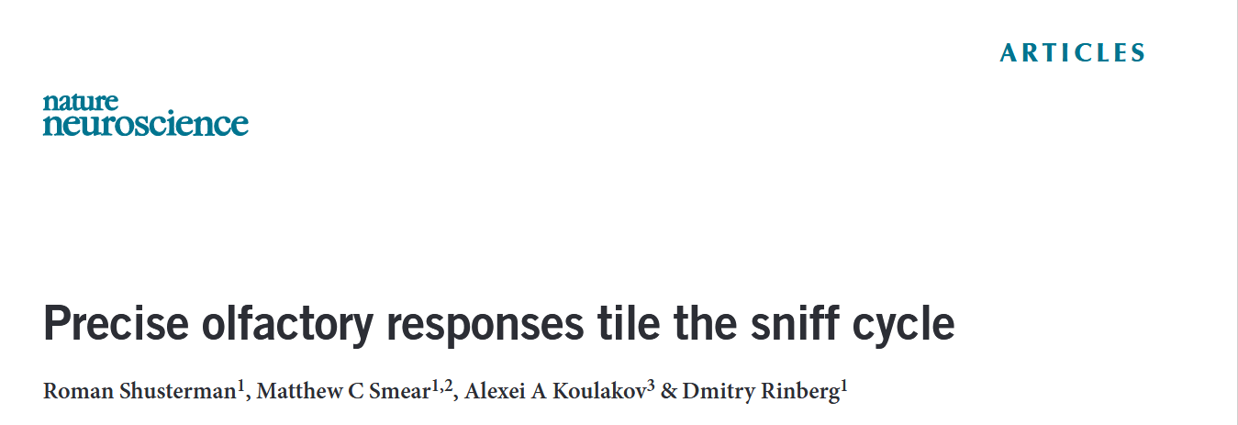
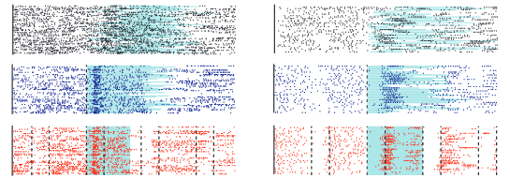
Sniffing and place
OB LFPs track sniffing
Nasal respiration is necessary and sufficient
Single units tuned to time/phase in sniff cycle
(Shusterman et al., 2011)

Slide 16

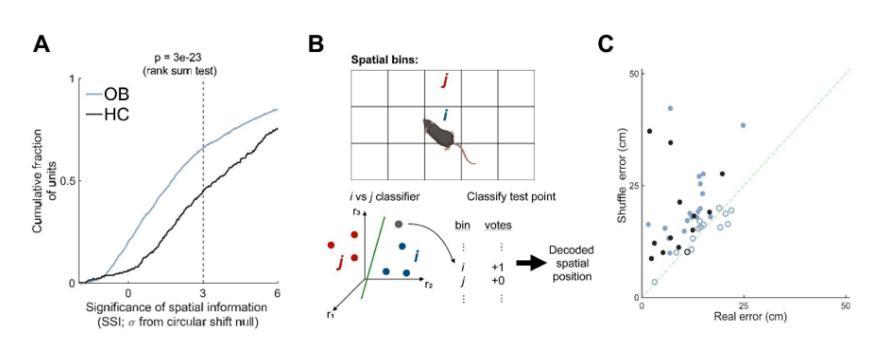
Sniffing and place
OB LFPs track sniffing
Nasal respiration is necessary and sufficient
Single units tuned to time/phase in sniff cycle
Single units tuned to place and population encodes allocentric space
(Sterrett et al., 2025)

Slide 17
Research Question
Are sniffing and spatial information formed from feedforward sensory inputs or sent through centrifugal feedback?
If information depends on feed-forward sensory inputs it cannot be used as an action grounding signal
Nor does it represent a cognitive map
Any information that remains in the absence of sensory inputs could be used for action grounding or represent the neuronal substrate of the cognitive map

Slide 18
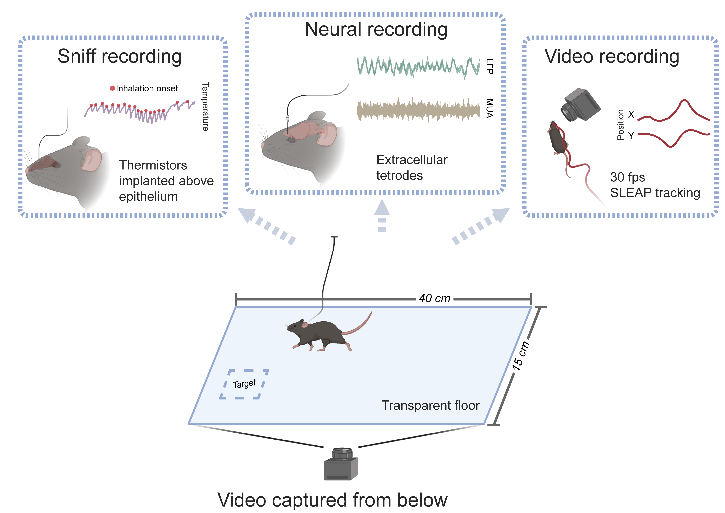
Experimental design
Foraging like task (clickbait)
Thermistor to record sniffing
Tetrodes implanted in OB and CA1
Bottom-up video tracking

Slide 19
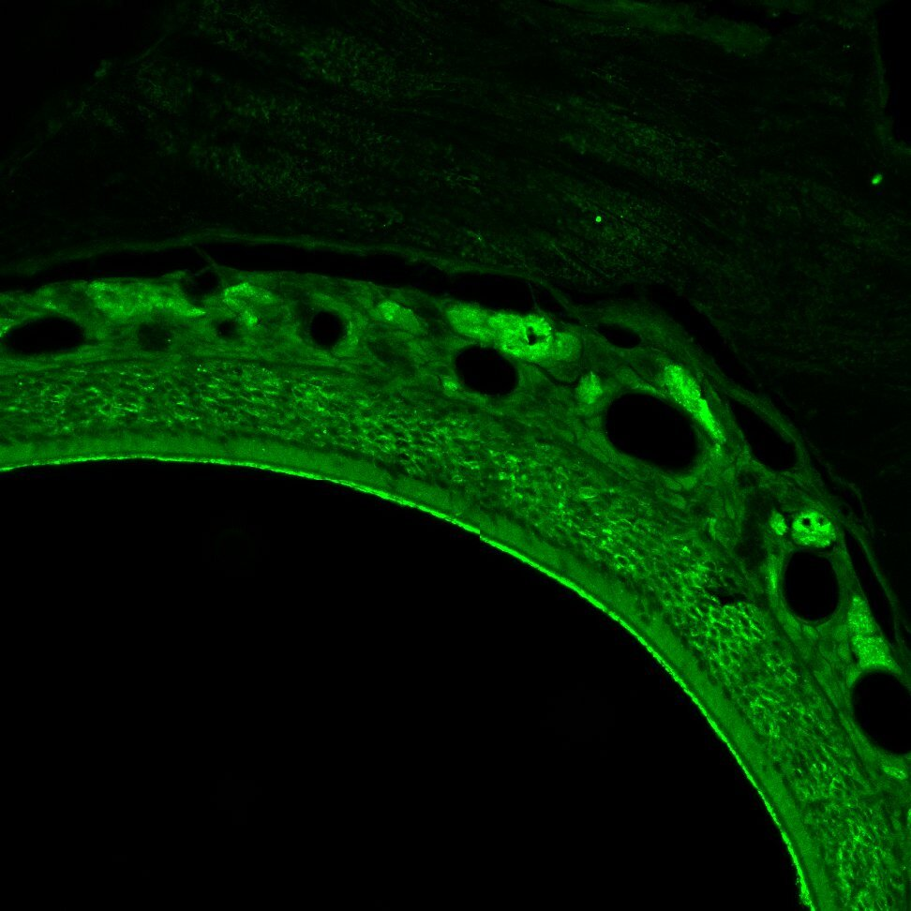

Experimental design
Foraging like task (clickbait)
Thermistor to record sniffing
Tetrodes implanted in OB and CA1
Bottom-up video tracking
MMZ to ablate olfactory sensory neurons
Pre injection
Post injection

Slide 20
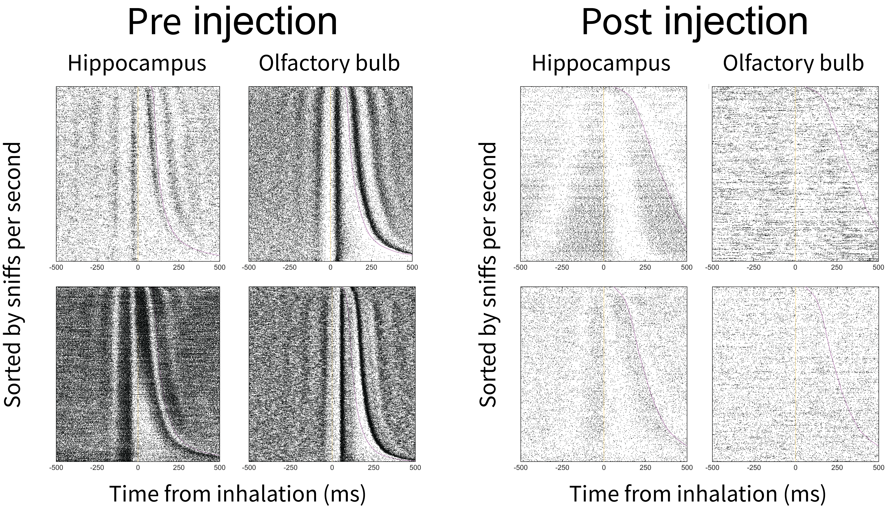
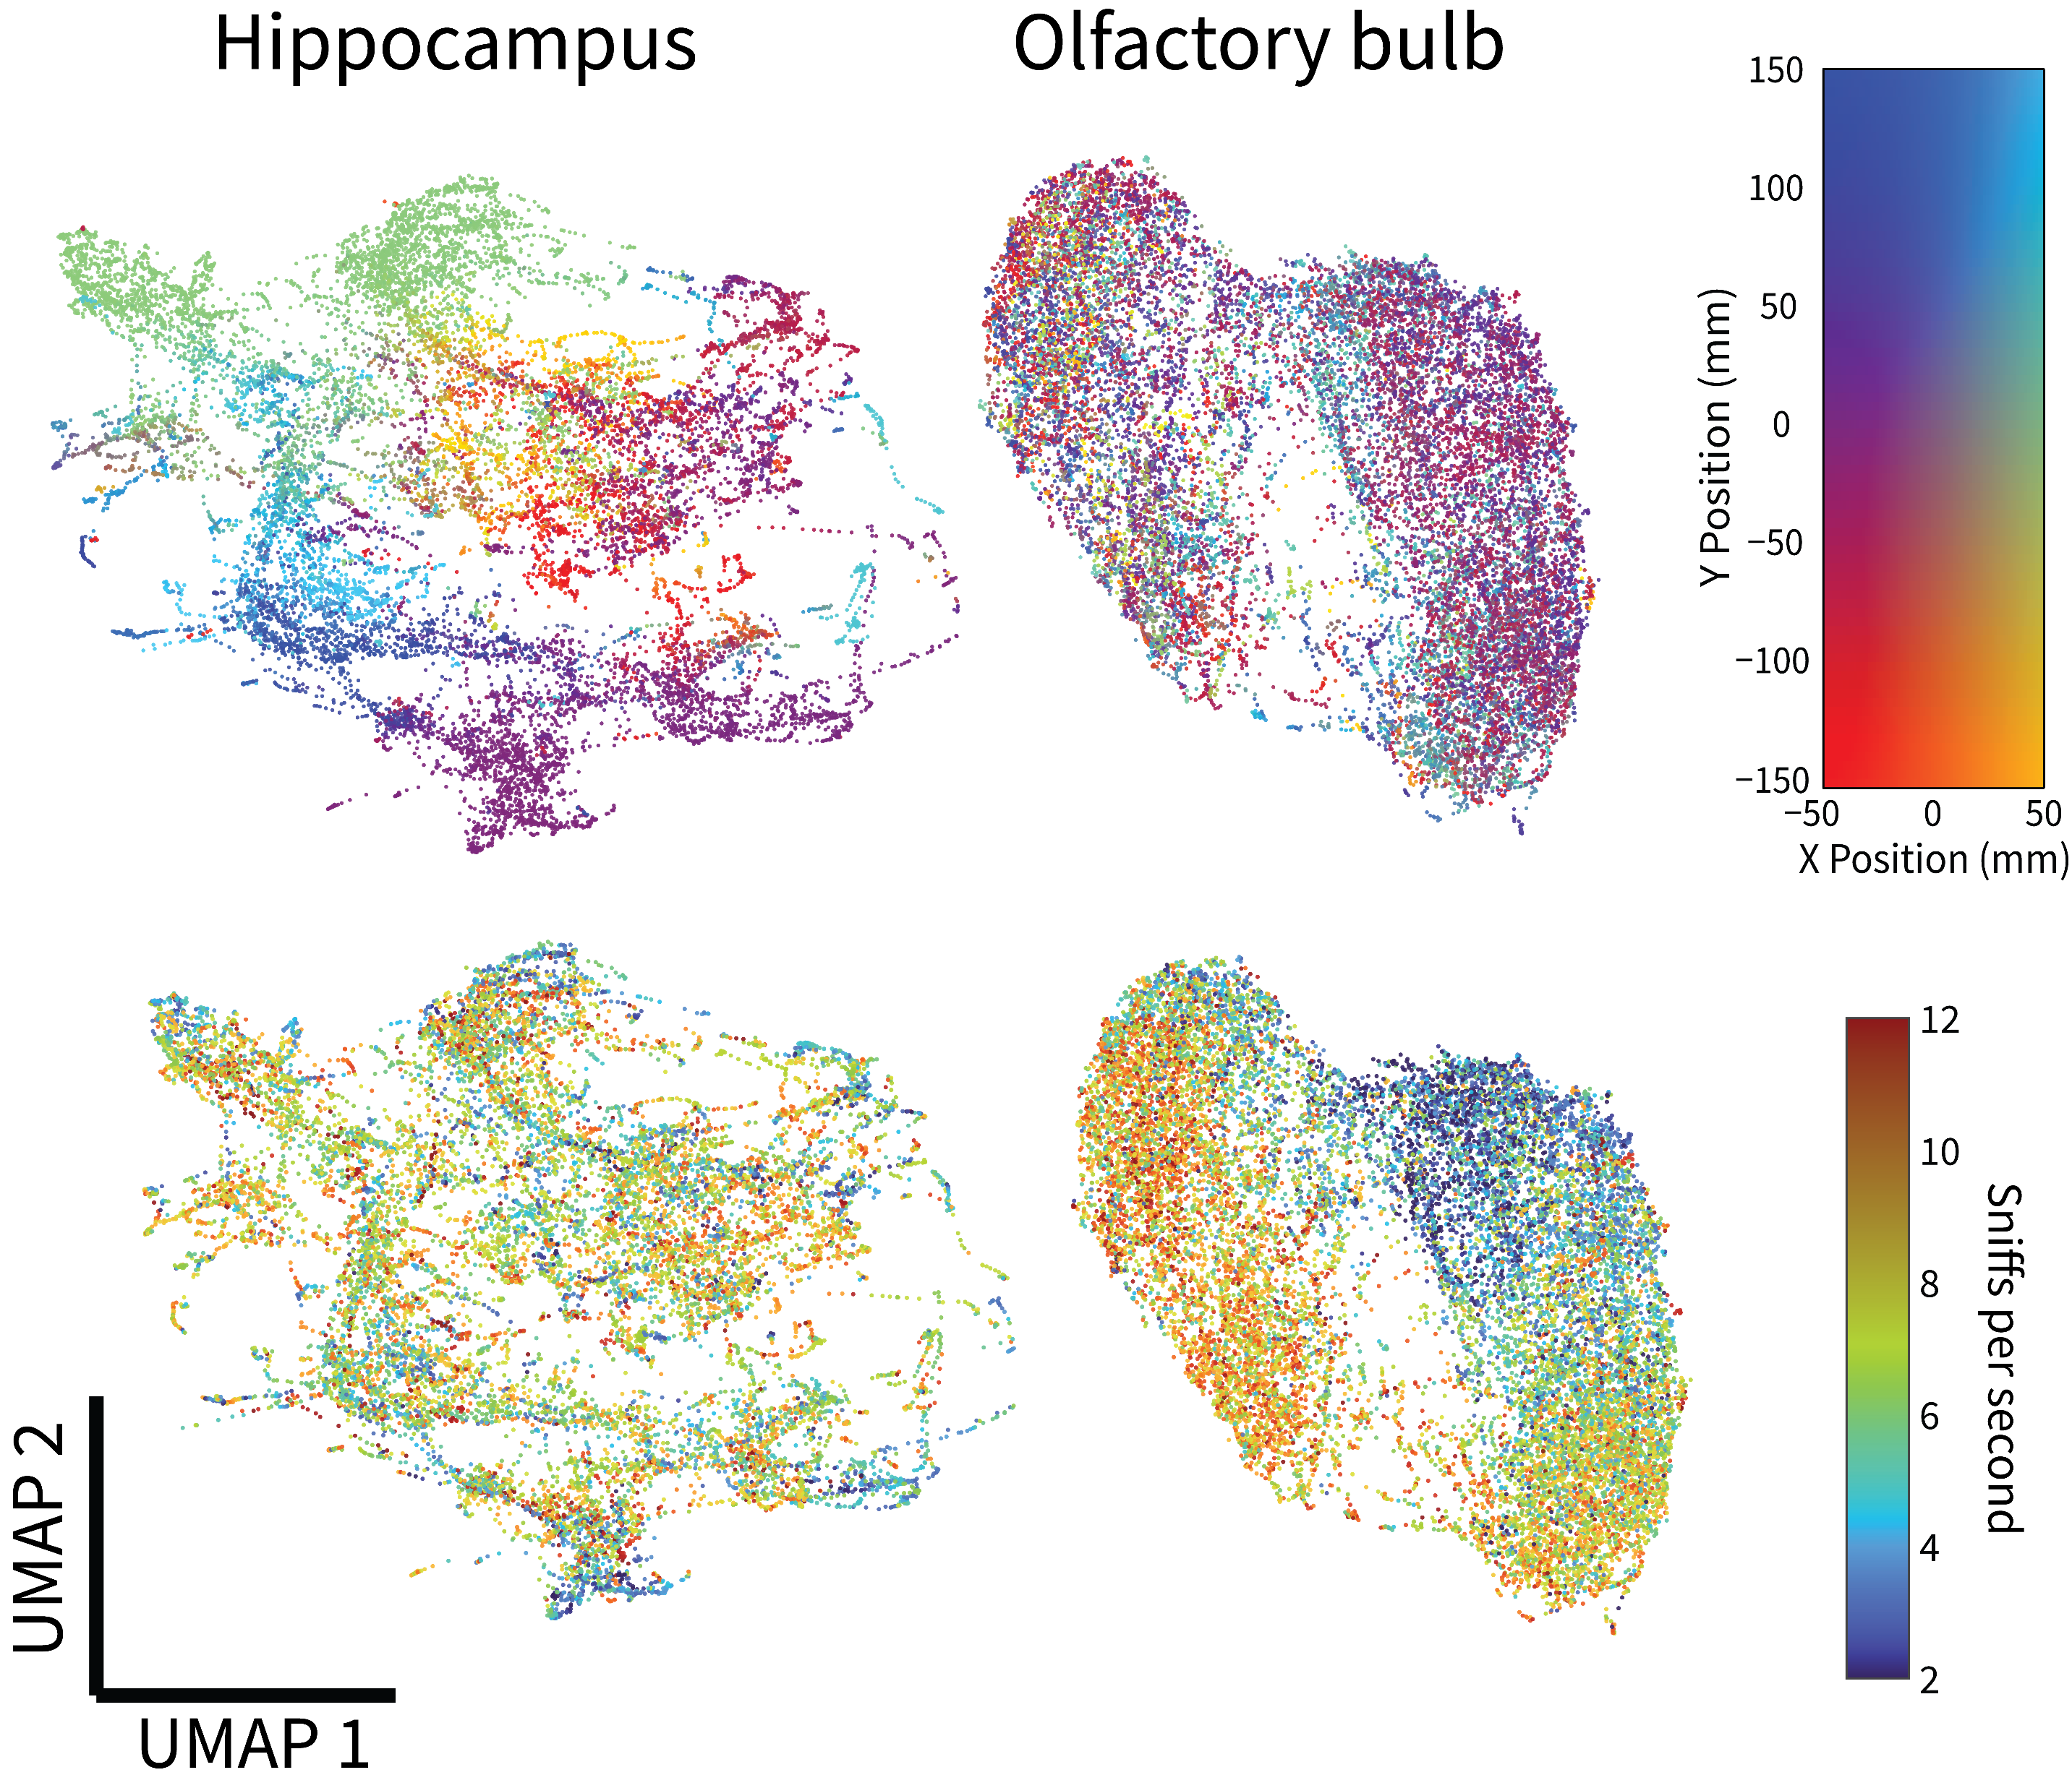
Results overview
Local field potentials
Single unit spiking
Population activity

Slide 21
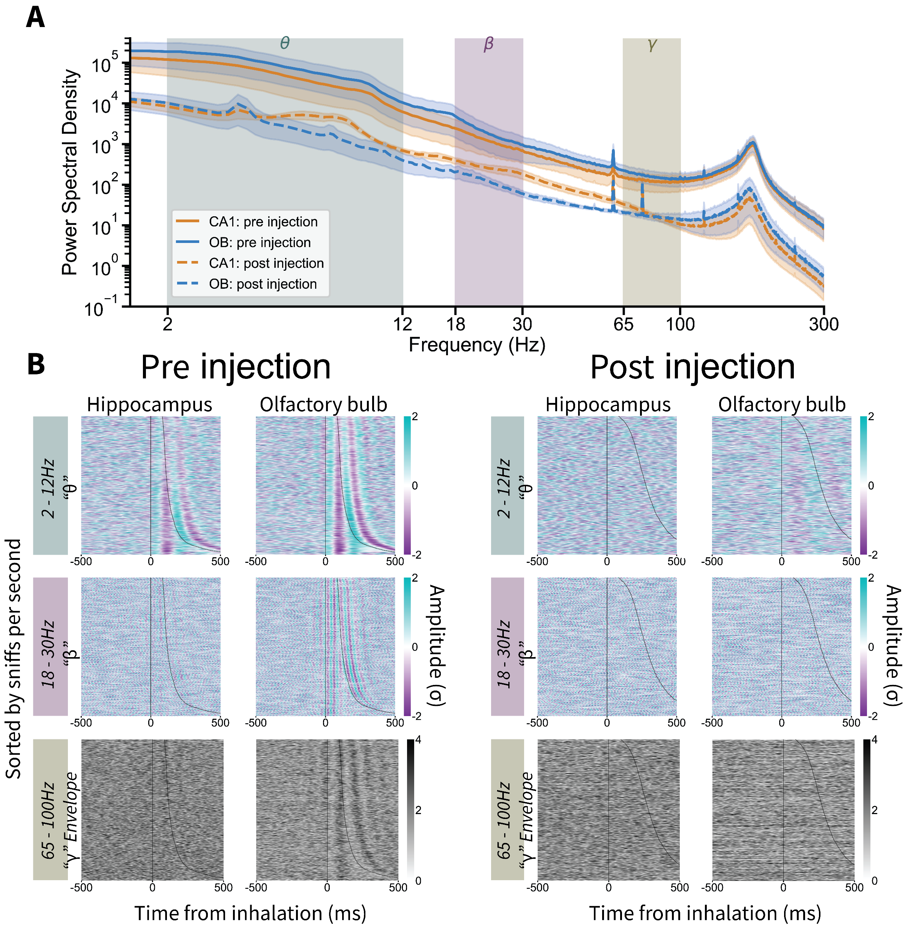
Sniff synchronous local field potentials
MMZ uniformly reduced power across spectra

Slide 22
Sniff synchronous local field potentials
MMZ uniformly reduced power across spectra
LFPs track respiration

Slide 23
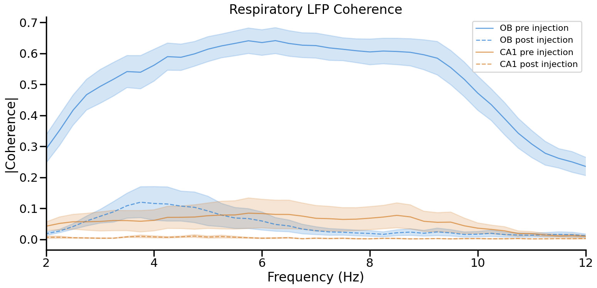
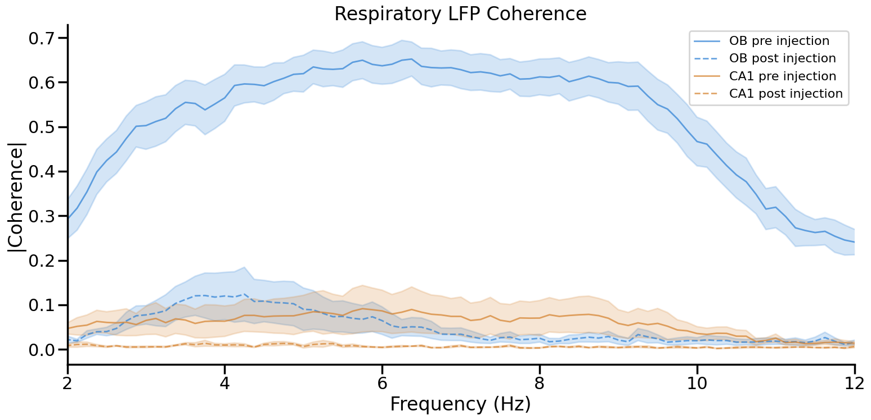
Sniff synchronous local field potentials
MMZ uniformly reduced power across spectra
LFPs track respiration

Slide 24
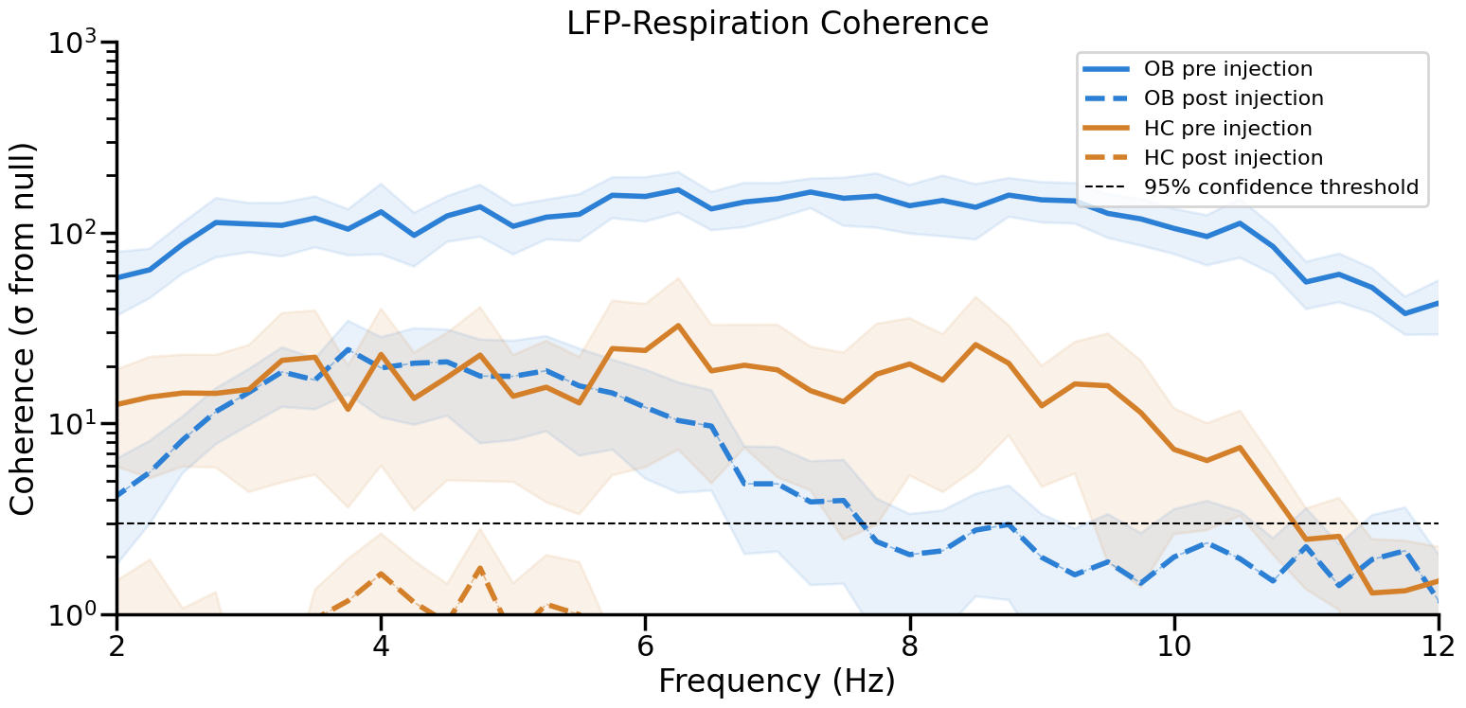
Sniff synchronous local field potentials
MMZ uniformly reduced power across spectra
LFPs track respiration

Slide 25
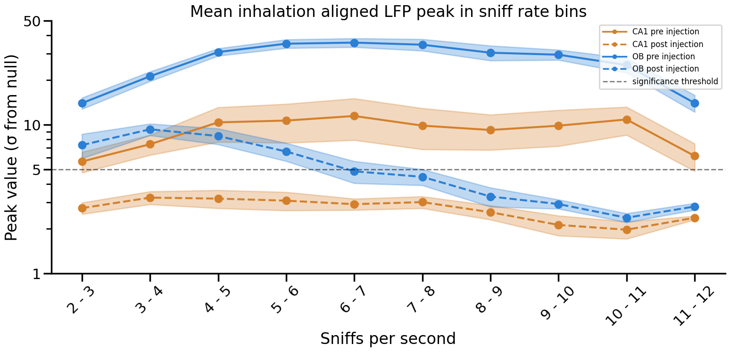
Sniff synchronous local field potentials
MMZ uniformly reduced power across spectra
LFPs track respiration

Slide 26
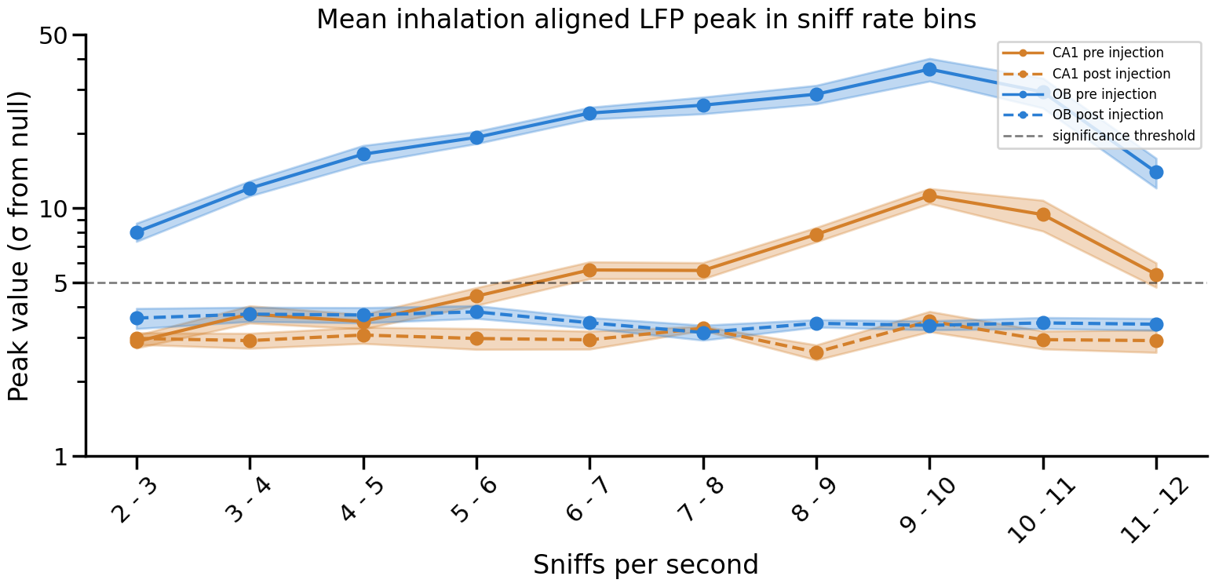
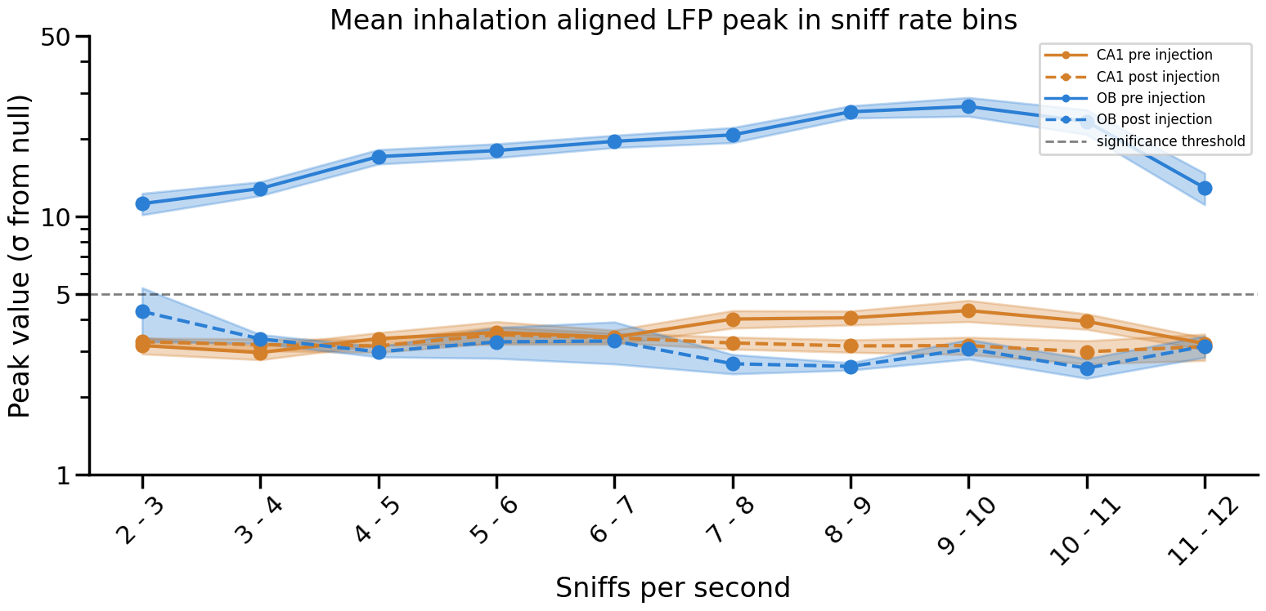
Sniff synchronous local field potentials
18 - 30Hz ‘β’
MMZ uniformly reduced power across spectra
LFPs track respiration
MMZ disrupts alignment with respiration
65 - 100Hz ‘γ’

Slide 27
Sniff synchronous local field potentials
18 - 30Hz ‘β’
MMZ uniformly reduced power across spectra
LFPs track respiration
MMZ disrupts alignment with respiration
65 - 100Hz ‘γ’

Slide 28
Sniff synchronous local field potentials
2 - 12Hz ‘θ/RR’
18 - 30Hz ‘β’
65 - 100Hz ‘γ burst’

Slide 29
Sniff synchronous spiking
OB single units follow inhalation

Slide 30
Sniff synchronous spiking
OB single units follow inhalation
CA1 single units precede inhalation

Slide 31
Sniff synchronous spiking
OB single units follow inhalation
CA1 single units precede inhalation
MMZ disrupts tuning in OB but not CA1

Slide 32
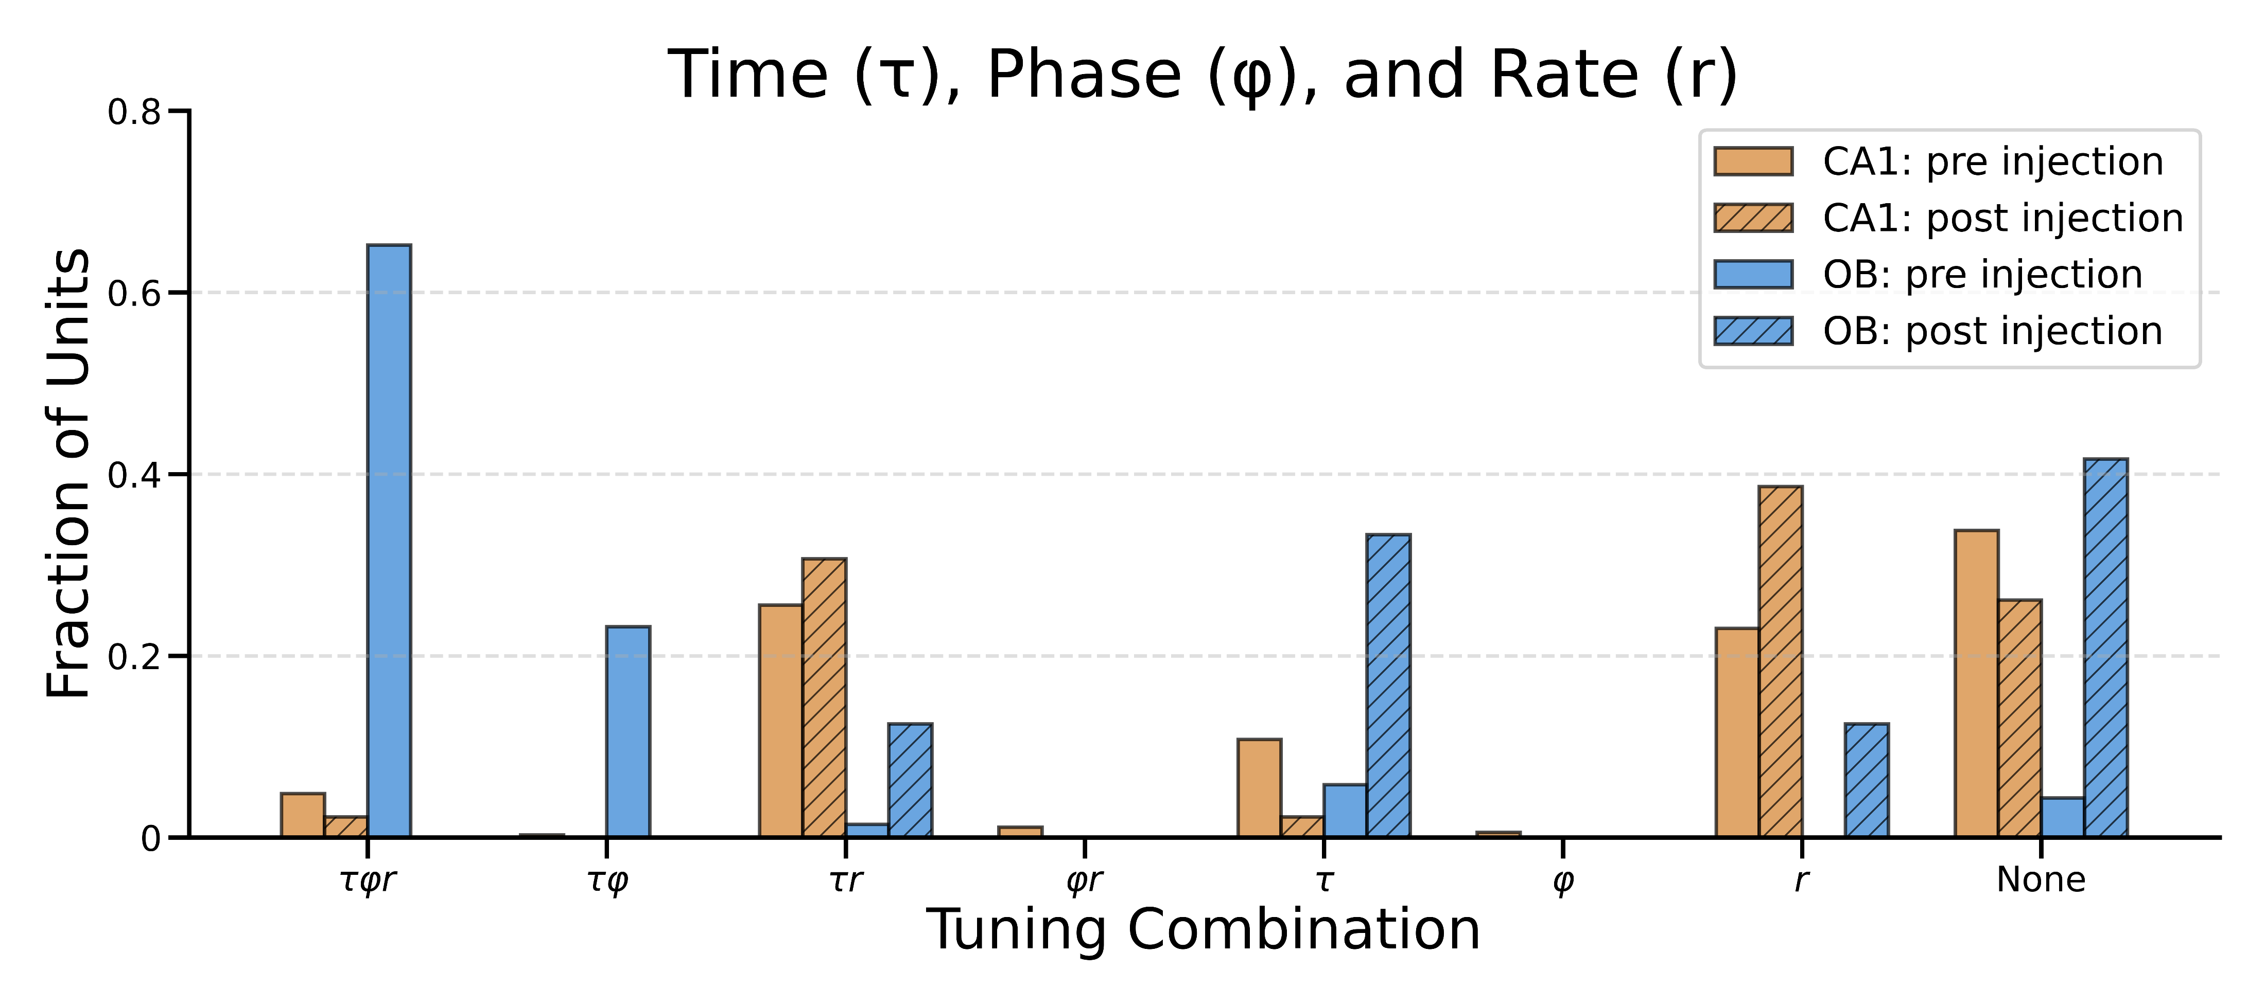
Sniff synchronous spiking
OB single units follow inhalation
CA1 single units precede inhalation
MMZ disrupts tuning in OB but not CA1
PGAM quantifies tuning

Slide 33
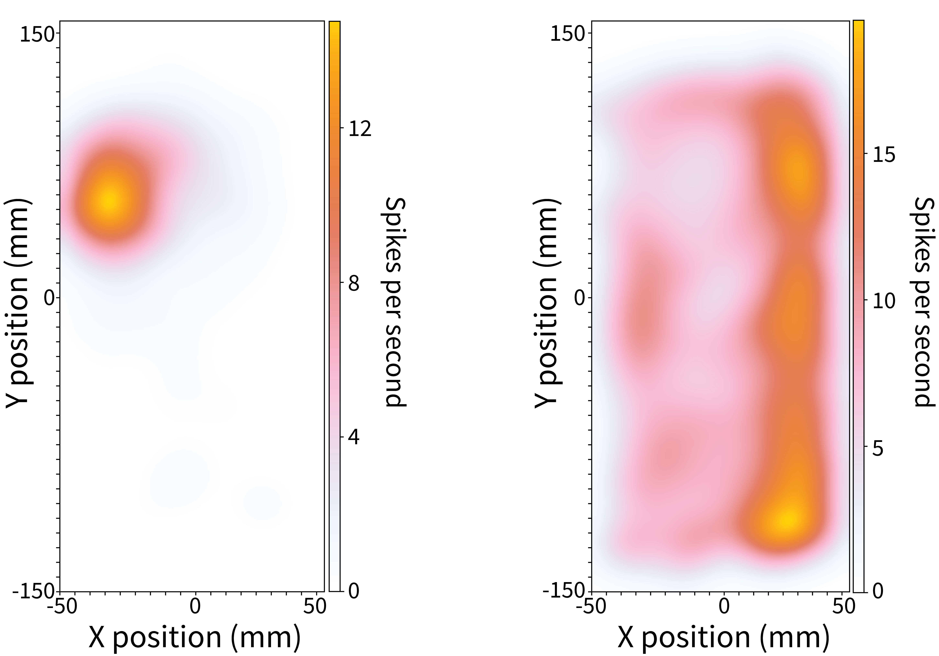
Spatial olfactory code
Place cells in CA1 and spatial tuned OB units
Hippocampus
Olfactory bulb

Slide 34
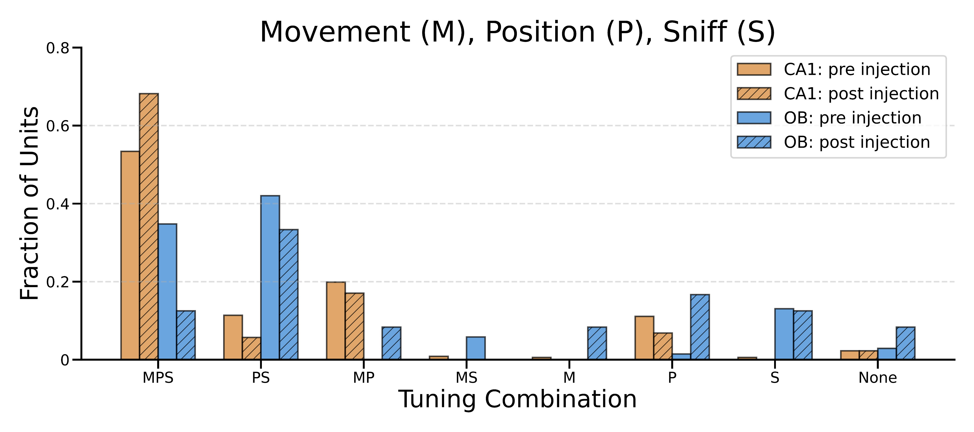
Spatial olfactory code
Place cells in CA1 and spatial tuned OB units

Slide 35
Population correlations
Populations encodes position and sniff rates

Slide 36
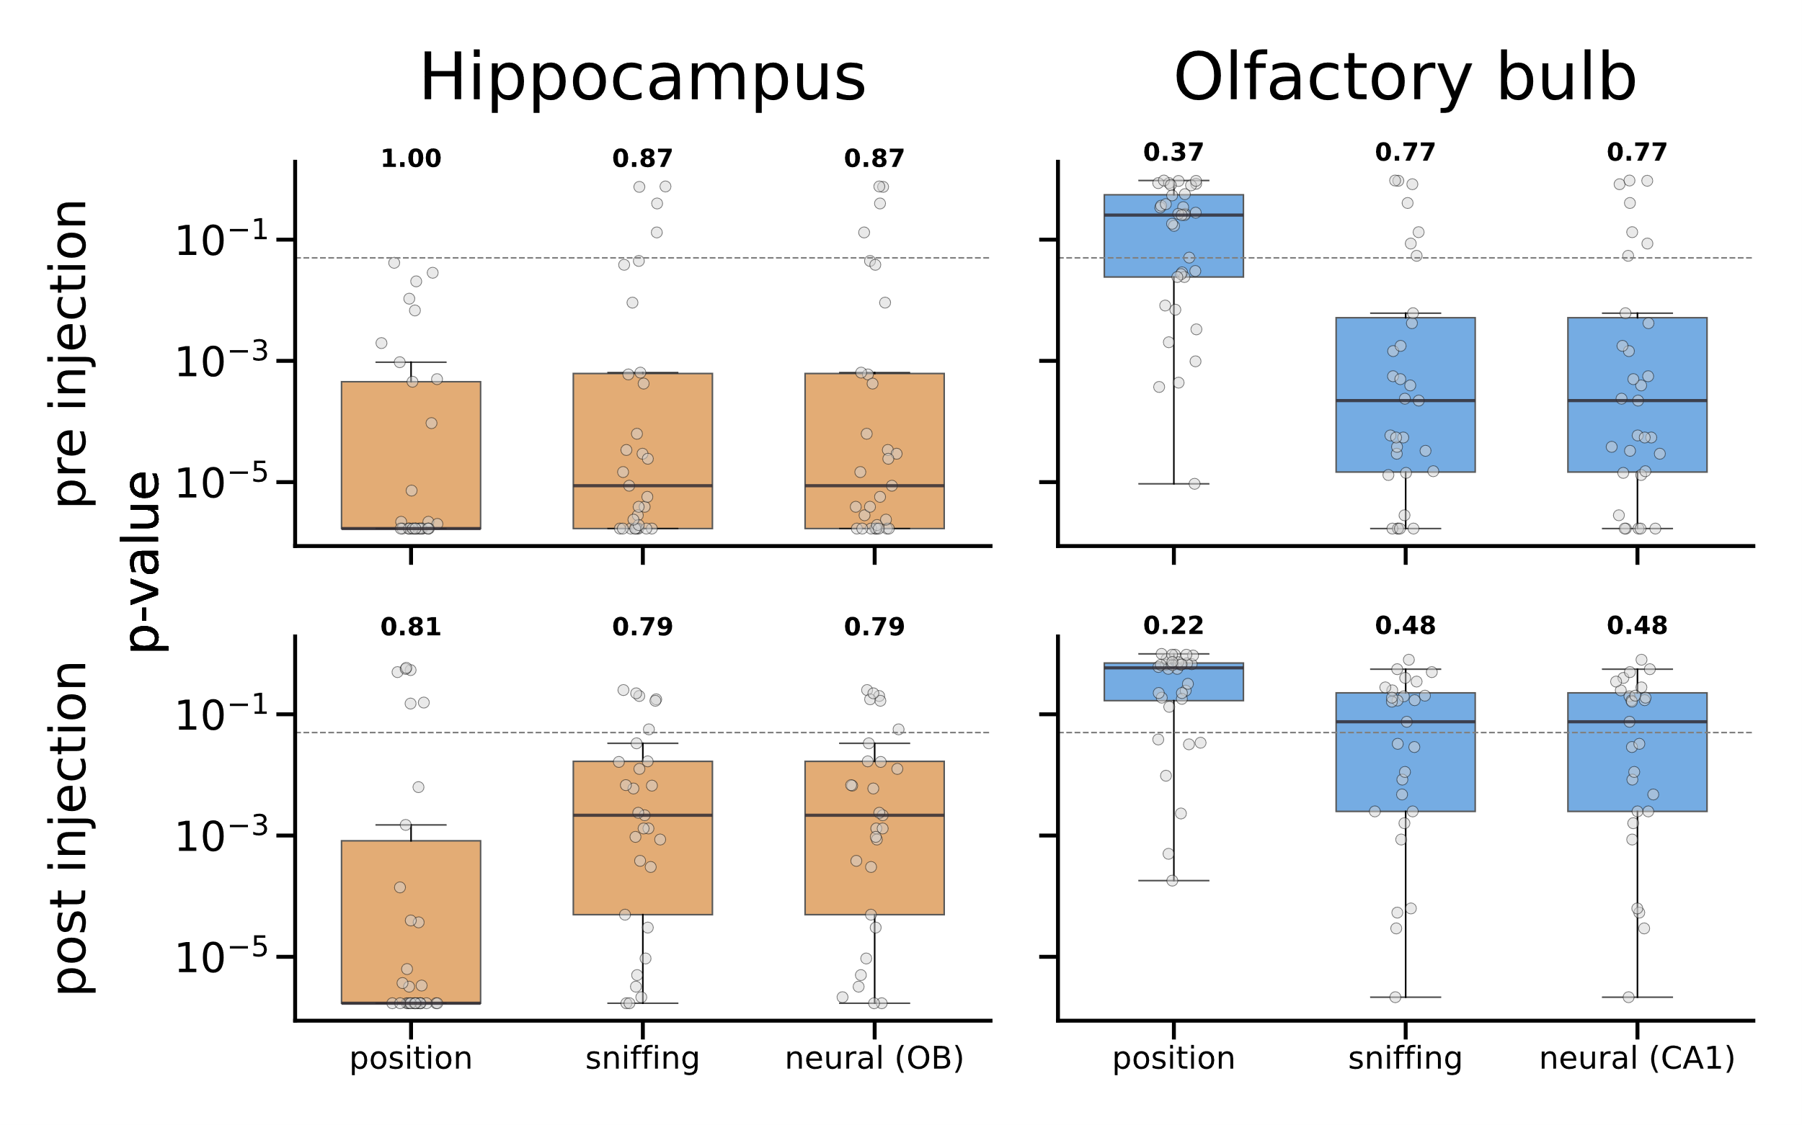
Population correlations
Populations encodes position and sniff rates
LSTM decoding

Slide 37
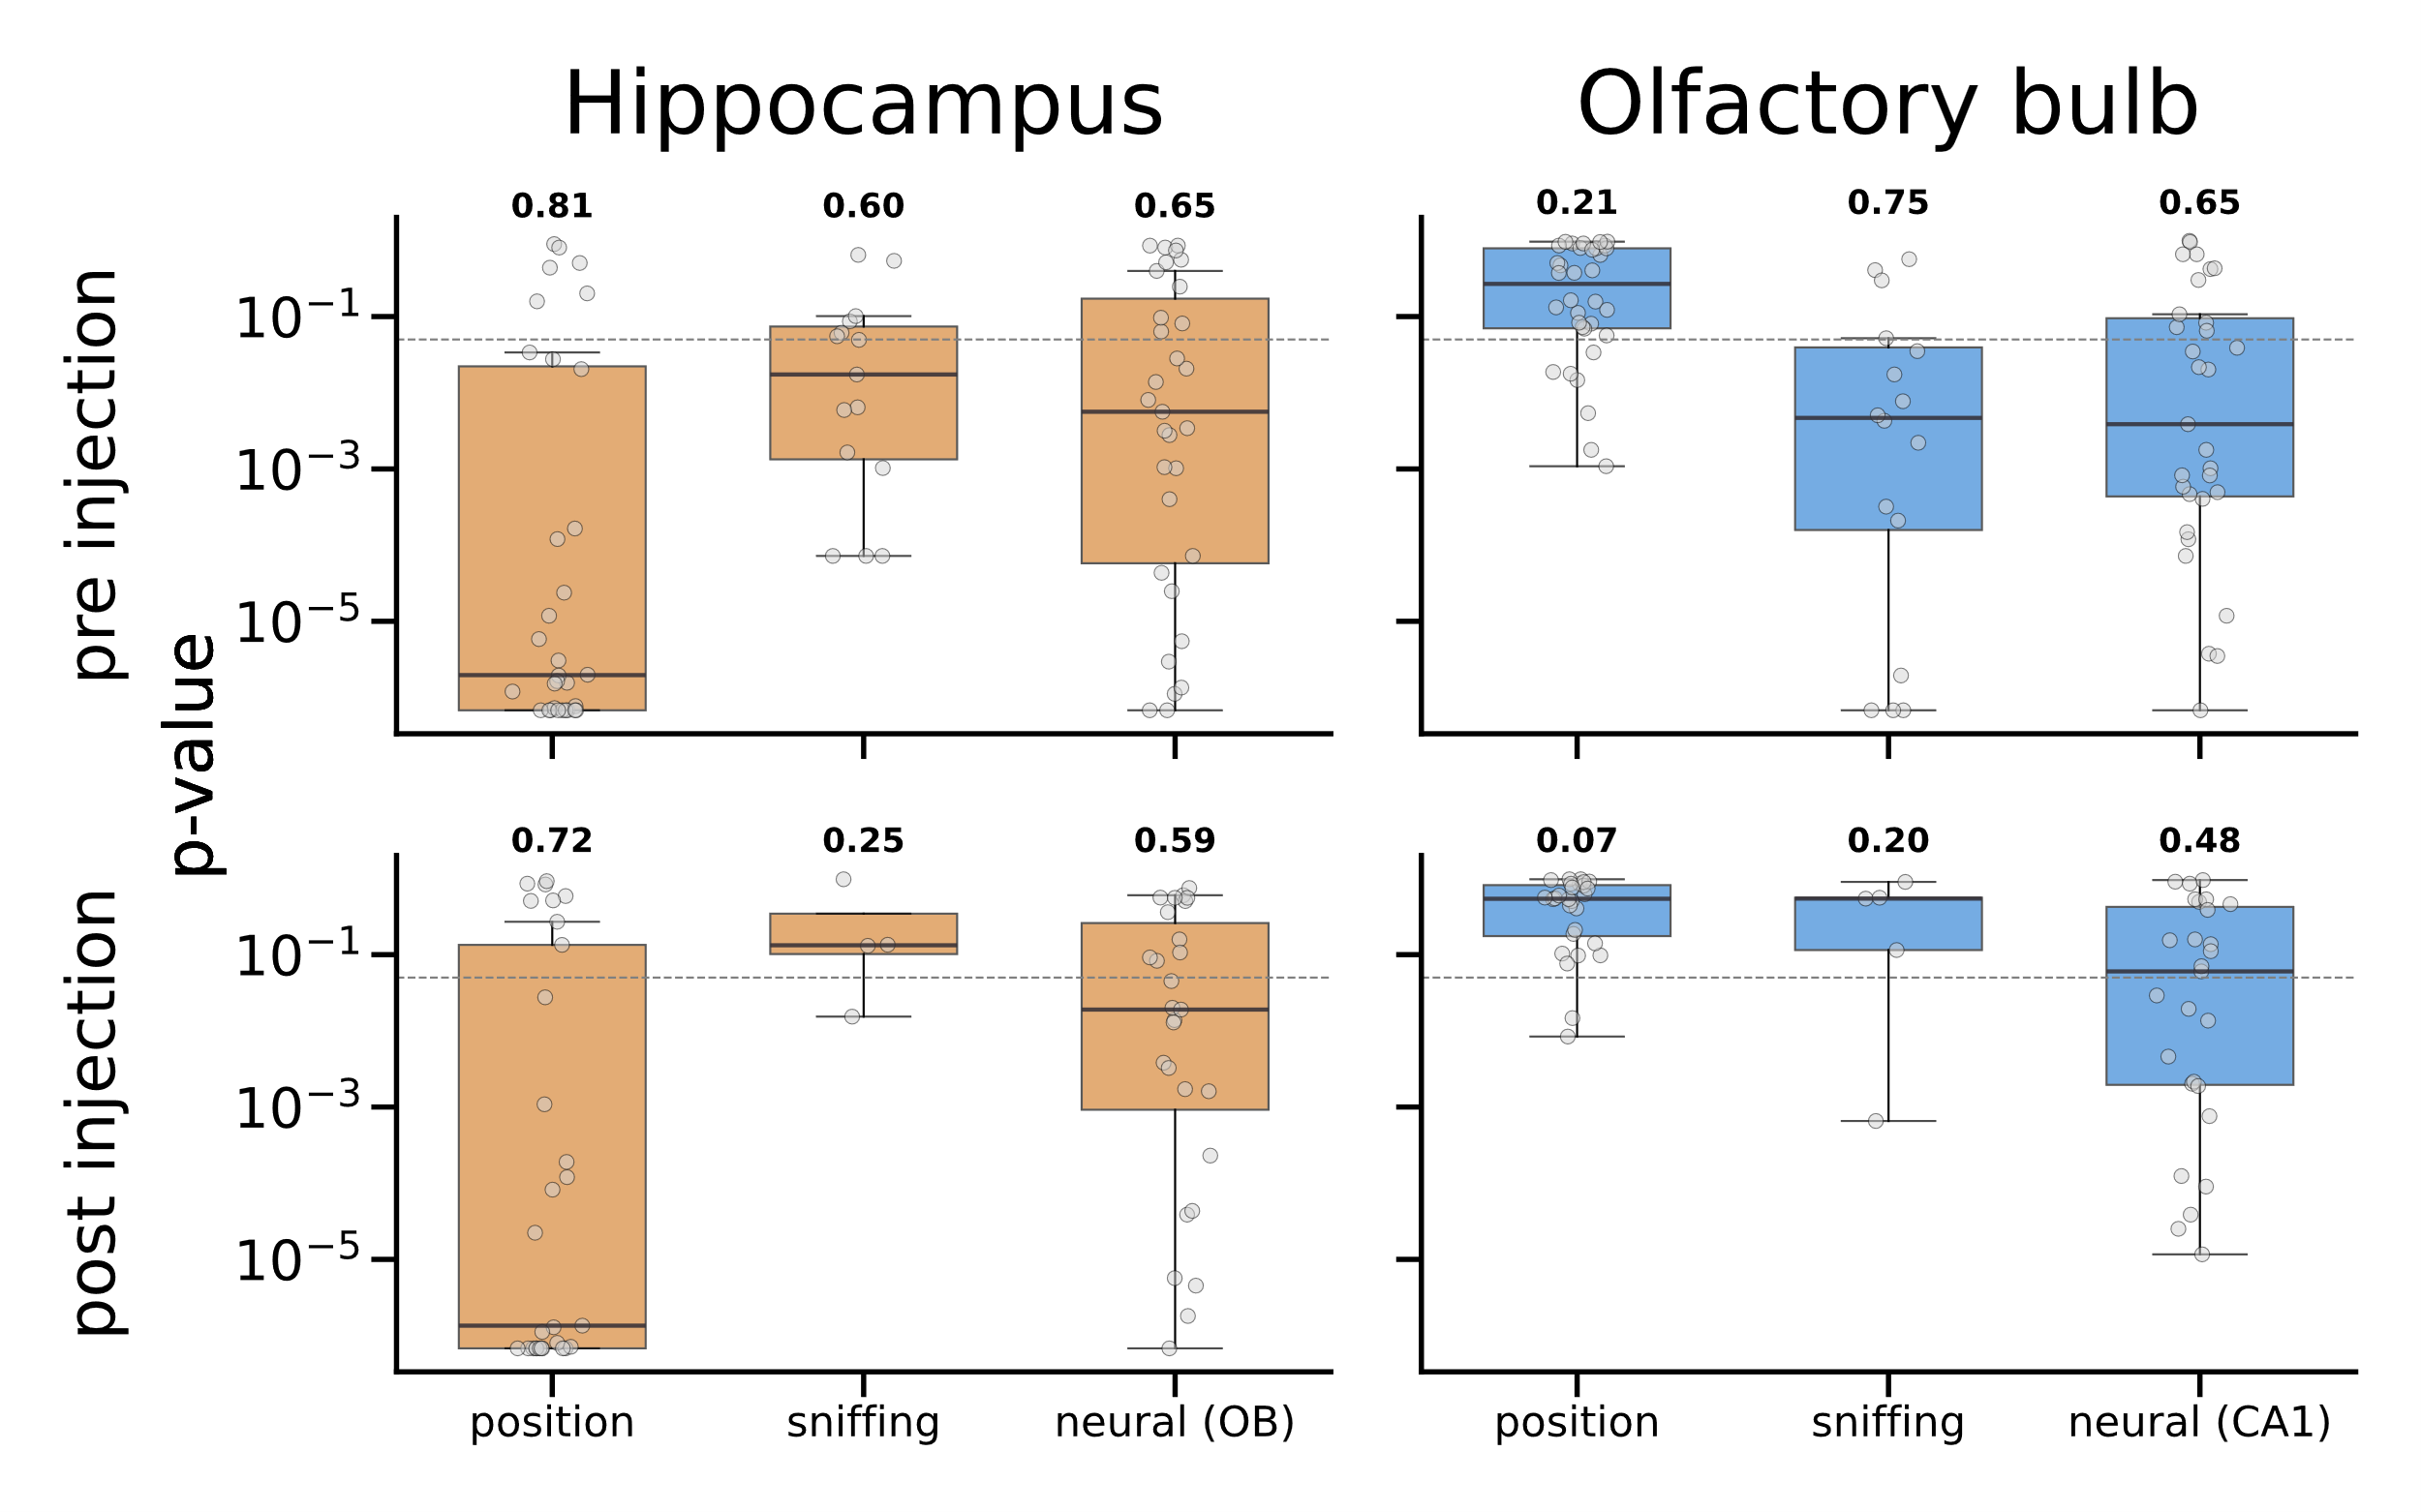
Population correlations
Populations encodes position and sniff rates
LSTM decoding
Kalman filter decoding

Slide 38
Discussion
Olfactory bulb encodes allocentric space in the absence of chemosensory inputs
Precise timing of OB activity relative to respiration depends on chemosensory inputs
Single unit spiking, beta and gamma oscillations
Hippocampal LFPs lose synchrony with respiration after ablation of olfactory sensory neurons
Respiratory oscillations as a global timing mechanism

